Slide 1
Topic 5
Introduction to UML Diagrams

Slide 2
Objectives
To introduce UML Diagrams
A diagrammatic way of showing the relationships among classes
This will help our understanding of the definitions of our collections and the usage of our collections in applications
1-2

Slide 3
UML Diagrams
Unified Modeling Language (UML) is a standard notation for object-oriented design
Used to model object-oriented designs
Shows overall design of a solution
Shows class specifications
Shows how classes interact with each other
Diagrams use specific icons and notations
It is language independent
1-3
Notes:
unified: the synthesis of 3 separate notations

Slide 4
UML Class Diagram
A class is represented in a UML diagram by a rectangle divided into 3 sections:
name of the class
attributes of the class (i.e. the data fields of the class, including variables and constants)
operations of the class (essentially equivalent to a Java method or a C++ function)
1-4

Slide 5
Example: UML Class Diagram
Person
firstName lastName email
getName() getEmail() setEmail( ) equals( ) toString()
1-5
Notes:
5

Slide 6
Example: UML Class Diagram
SocialNetwork
friendList numFriends DEFAULT_MAX_FRIENDS
add( ) remove() toString()
1-6

Slide 7
Features of UML Class Diagrams
Attributes and operations may include:
visibility: public (+) or private (-)
type of attribute or operation
parameter list for operations
Including this information is of the form: visibility variable_name: type visibility variable_name: type = default_value visibility method_name(parameter_list): return_type {property}
1-7

Slide 8
Example: UML Class Diagram
SocialNetwork
- friendList: array of Person - numFriends: integer - DEFAULT_MAX_FRIENDS = 100
+ add(friend: Person ) + remove(friend: Person): boolean + toString(): String
1-8
Notes:
8

Slide 9
Features of UML Class Diagrams
Attributes and operations may be left incomplete, and completed as design is developed

Slide 10
Set of UML Class Diagrams
A set of UML class diagrams shows:
The classes used in the system
The relationships among classes
The constraints on the connections among classes
1-10

Slide 11
Example: UML Diagram for Order Processing
Order
dateReceived isPrepaid orderNumber price
dispatch( ) close( )
Customer
name address
getCreditRating( )
*
1
1
*
CorporateCustomer
contactName creditRating creditLimit salesRep
remind( ) billForMonth( )
PersonalCustomer
customerCardNumber
OrderLine
quantity price product
1-11
Notes:
11

Slide 12
Features of Set of UML Diagrams
Association between classes:
Represents a relationship between objects of those classes
Indicated with a solid line between the classes
Can be annotated with cardinality: indicates a numeric association between classes, such as:
one-to-one
one-to-many ( 1..* )
many-to-many ( *..* )
zero-to-many (0..*)
zero-to-5 (0..5)
etc.
1-12

Slide 13
Example: Association Between Classes
LibraryCustomer
name address
register( ) deregister( )
LibraryItem
callNumber title
checkout( ) return( )
0 .. *
0 .. *
1-13
Notes:
e.g.
- A LibraryCustomer may check out 0 or many LibraryItems.
- A LibraryItem may have been checked out by 0 or many LibraryCustomers.

Slide 14
Association Between Classes
What is the Order-Customer relationship in our Order Processing System?
How would we annotate that a Library Customer can not check out more than 5 library items?
Notes:
An order has exactly one customer, but a customer might place 0 or many orders.
Change the multiplicity so that it has 0 to 5.

Slide 15
Features of Set of UML Diagrams
Usage of another class:
Broken line with an arrow indicates that one class makes use of the other
Line can be labeled with a message indicating the type of usage

Slide 16
Example: One Class Indicating its Use of Another
LibraryCustomer
name address
register( ) deregister( )
Computer
location ipAddress
logon( ) logoff( )
Searches online
catalogue
1-16

Slide 17
Features of Set of UML Diagrams
Implementation of an interface:
Indicated by a broken line with an open arrow
UML diagram for an interface is much like the UML diagram for a class
But there are no attributes (why not?)

Slide 18
UML Diagram for StackADT Interface
<<interface>> StackADT
push( ) pop( ) peek( ) isEmpty( ) size( ) toString( )

Slide 19
UML Diagram for ArrayStack Implementation of StackADT
ArrayStack
stack top
push( ) pop( ) peek( ) isEmpty( ) size( ) toString( )
<<interface>> StackADT
push( ) pop( ) peek( ) isEmpty( ) size( ) toString( )

Slide 20
UML Diagram for Postfix Expression Program
ArrayStack
stack top
push( ) pop( ) peek( ) isEmpty( ) size( ) toString( )
<<interface>> StackADT
push( ) pop( ) peek( ) isEmpty( ) size( ) toString( )
PostfixEvaluator
stack
evaluate( ) isOperator( ) evalSingleOp()
Postfix
main( )

Slide 21
Features of Set of UML Diagrams
Inheritance:
An arrow on an association line indicates that one class is derived from the other

Slide 22
Example: Inheritance Relationships
LibraryItem
title callNumber
checkout( ) return( )
Book
author publisher
Video
producer studio
1-22
Notes:
22

Slide 23
Example: Inheritance Relationships
BankAccount
accountNumber balance
deposit() withdraw( ) etc.
SavingsAccount
interestRate
addInterest() getInterestRate() setInterestRate()
CheckingAccount
transactionCount
deposit() withdraw() deductFees() getTransactionCount()
1-23
Notes:
23

Slide 24
Summary
http://www.classdraw.com/help.htm

Slide 25
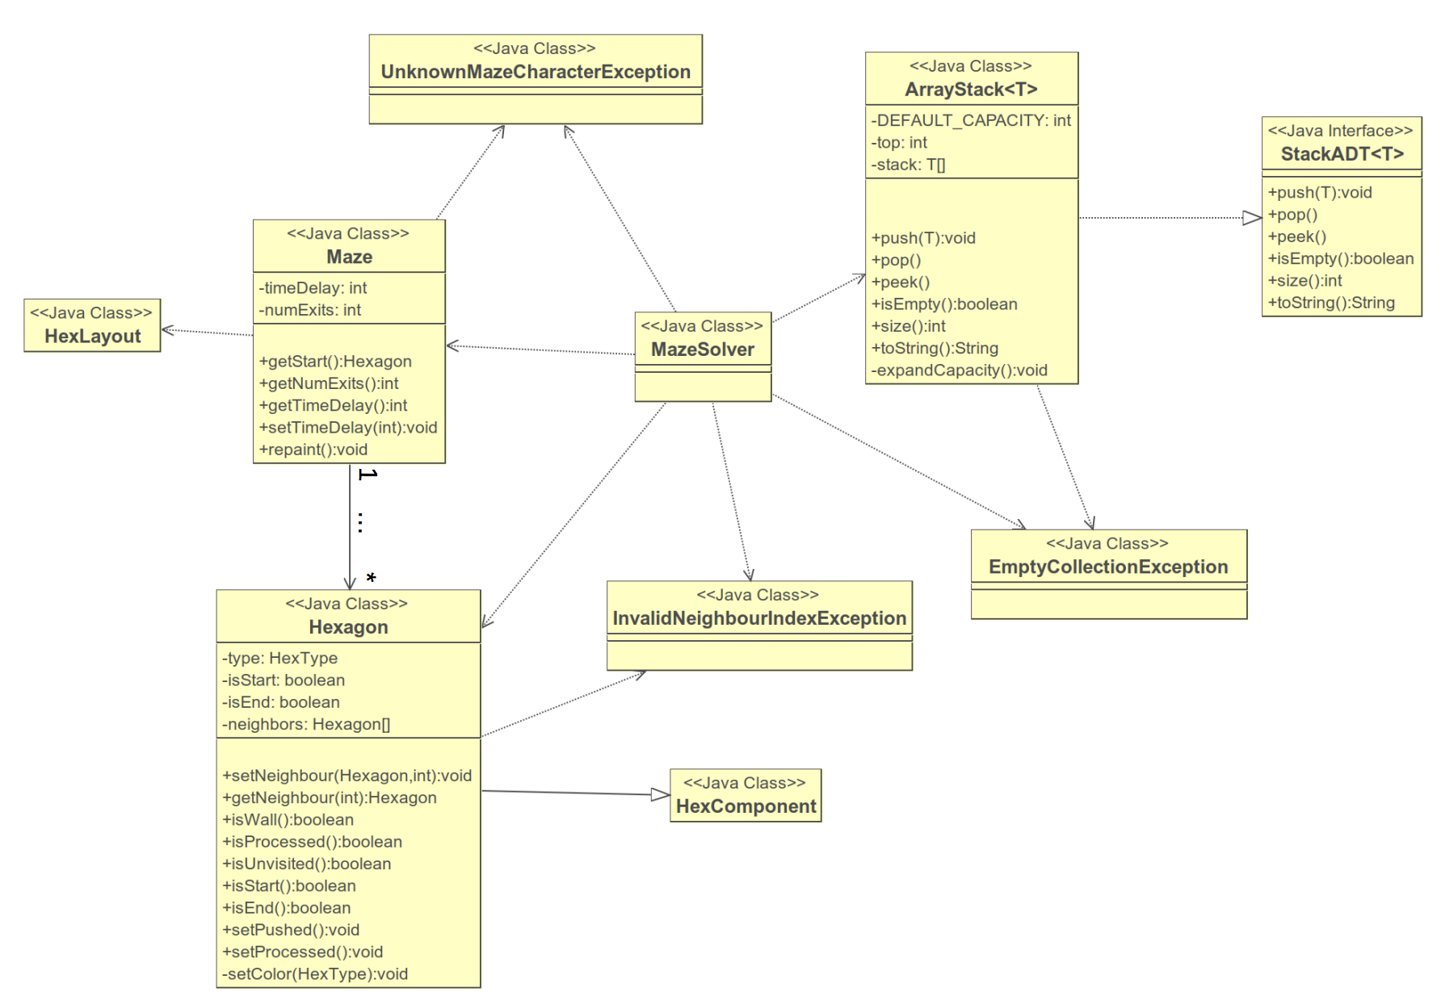

Slide 26
Example – Social Network
Users log into account using FaceSpace credentials.
Users can view profile pages, which have a profile picture, basic friend information, posts, and links to other features.
Users can post links, status updates, photos, and videos on their own profile page and on friends’ profiles pages.
Users can send friend requests.
Users can view a list of their friends.
Users can review friend requests and accept or reject.

Slide 27
Example – Social Network
Candidate Classes – start with essential data representation.
UserAccount
Profile
PersonInformation
Post
PhotoPost
VideoPost
StatusPost
FriendList
FriendRequest
Any others?

Slide 28
Example – Social Network
UserAccount
Profile myProfile
…
1
Post
Date dateCreated
Date dateLastEdited
*
1
Profile
PersonInformation info
Photo profilePic
Collection<Post> profilePosts
…
1
StatusPost
String statusText
…
PhotoPost
Photo photo
…
VideoPost
Video video
Photo thumbnail
…
Notes:
A profile owns 0 to many posts

Slide 29
Example – Social Network
Candidate Classes – consider program logic. What do we need?
“Users log into account…”
We need a class to manage authentication.
UserAuthenticator classes
For now, sufficient to identify this as a single class
We will refine this later
“Users can view profile pages…”
It is possible that all programming needed to view profiles can be done at the UI level.
Question: Will the UI read information directly from the ‘model’ level, or do we need an intermediary class to help?

Slide 30
Example – Social Network
Recall that we want as little logic as possible at the domain/model level.
We will need additional programming logic to control which users have access to which profiles.
This suggests we will need a ‘controller’ class to sit between the UI and the model.

Slide 31
Example – Social Network
ProfileDisplayController
UserAccount currentUser
hasPermission(profile)
getProfileInfo(profile)
<<uses>>
<<REST>>
Profile
PersonInformation info
Photo profilePic
Collection<Post> profilePosts
ProfileView
Notes:
Tags such as ’uses’ are optional, but include them if you find them helpful. The arrowheads should be used consistently.

Slide 32
Example - Grails
package facespace
class UserAccount {
String ownerName
static hasOne = [userProfile : Profile]
def getProfile(){
return userProfile
}
static constraints = {
userProfile nullable: true
}
}
package facespace
class Profile {
static belongsTo = [ownerAccount : UserAccount]
static hasMany = [posts : Post]
static constraints = {
posts nullable: true
}
}

Slide 33
Example - Grails
package facespace
class StatusPost extends Post{
String statusText
static constraints = {
statusText(maxSize: 180)
}
}
package facespace
class VideoPost extends Post{
String videoURL
String thumbnailURL
static constraints = {
videoURL nullable: true
thumbnailURL nullable: true
}
}

Slide 34
Example - Grails
package facespace
class BootStrap {
def init = { servletContext ->
def acc = new UserAccount(ownerName: 'Ethan').save()
def p = new Profile(ownerAccount: acc).save()
new StatusPost(statusText:'This is my first status update!', ownerProfile: p).save()
}
def destroy = {
}
}

Slide 35
Example Grails
package facespace
class ProfileDisplayController {
def index() {
def acc = new UserAccount(ownerName: 'Ethan')
def example = UserAccount.find(acc)
def posts = UserAccount.find(example).getProfile().getPosts()
for(Post p : posts){
if(p instanceof StatusPost){
String s = p.getStatusText();
render s
}
}
}
}

Slide 36
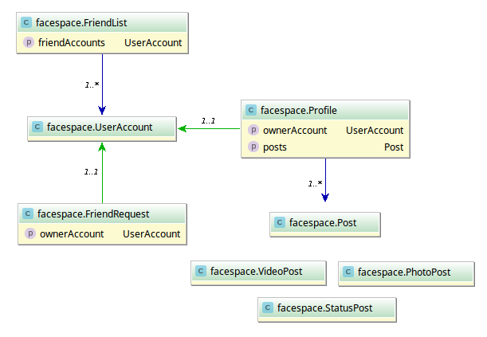
Example Grails

